Slide 1
Battle of the Stadiums
Capstone project by Dusan Zikic

Slide 2
Introduction
The project discovers similarities between football stadiums, based on defined criteria. For the purpose of this project the criteria will be:
stadium capacity
Venues around the stadium
GDP (Gross domestic product) of a country stadium is in

Slide 3
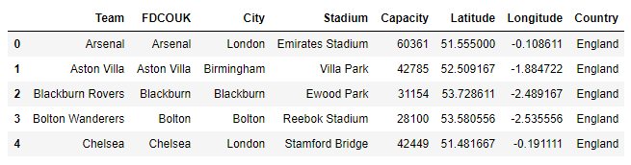
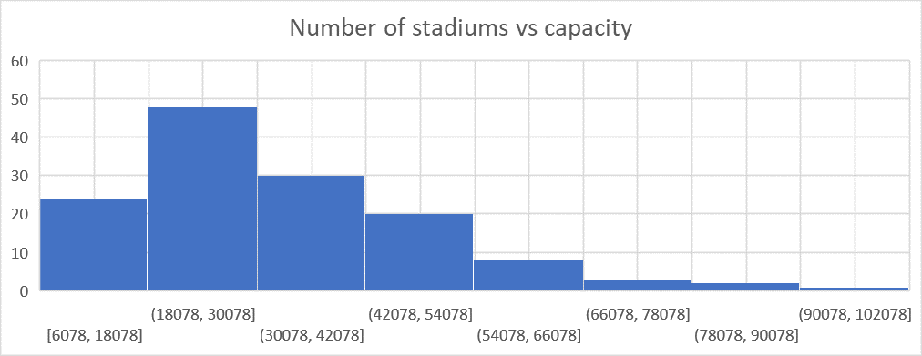
Data
Stadium data with geolocation and capacity

Slide 4
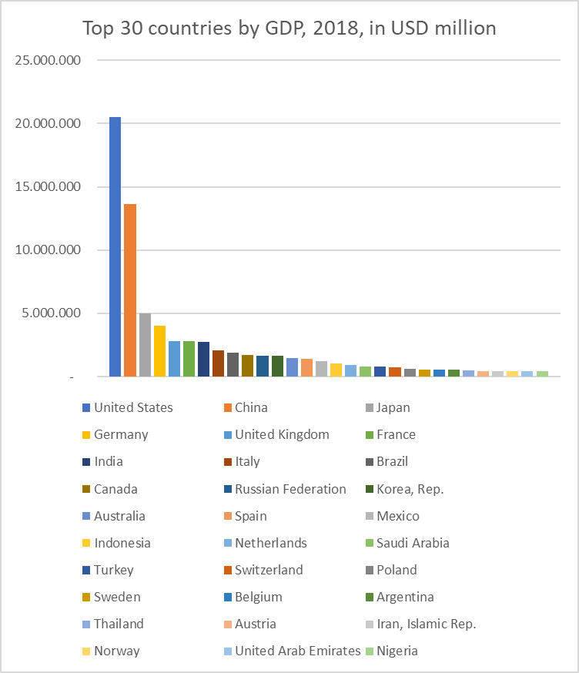
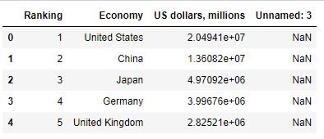
Data
GDP data, for 2018

Slide 5
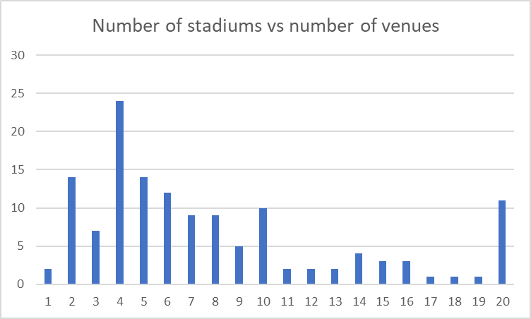
Data
Venues around stadiums. Source: Foursquare API

Slide 6
Methodology
K-Means clustering is an unsupervised learning algorithm that, as the name hints, finds a fixed number (k) of clusters in a set of data.
A cluster is a group of data points that are grouped together due to similarities in their features.
K-Means starts by randomly defining k centroids. From there, it works in iterative (repetitive) steps to perform two tasks:
1. Assign each data point to the closest corresponding centroid, using the standard Euclidean distance. In layman’s terms: the straight-line distance between the data point and the centroid.
2. For each centroid, calculate the mean of the values of all the points belonging to it. The mean value becomes the new value of the centroid.

Slide 7
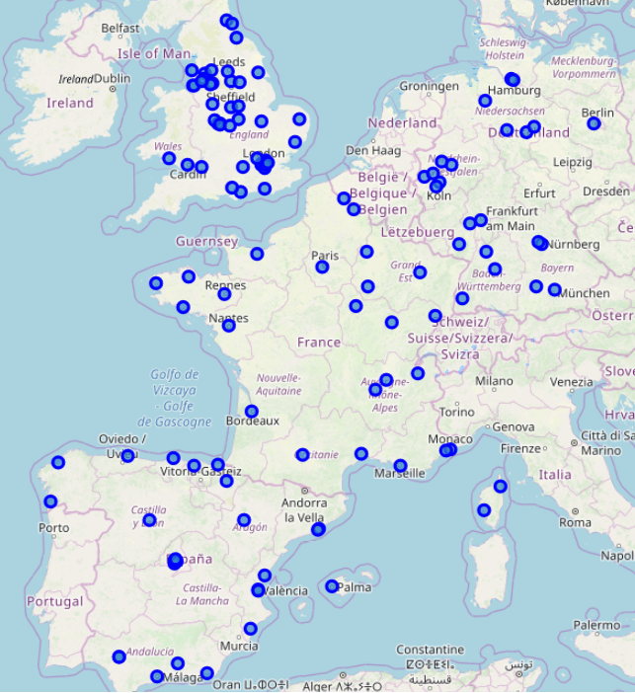
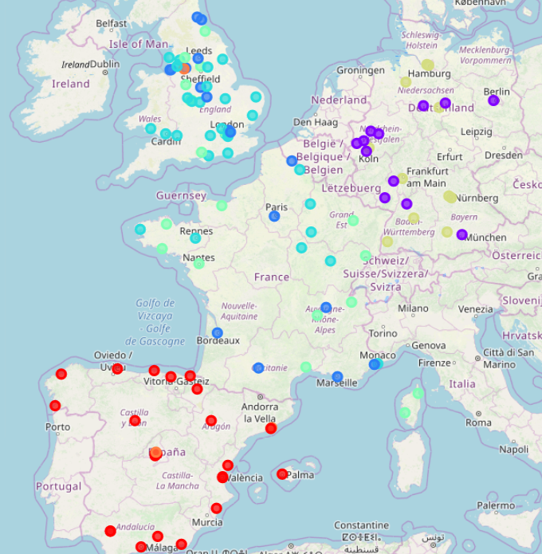
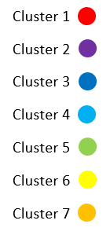
Result - Clusters

Slide 8
Discussion
Most interesting results
Some of the greatest archrivals, although from the same city were put into different clusters, examples are Manchester (United and City) and Madrid (Real and Atletico).
Cluster number 7 consists of only 3 stadiums/clubs, but they are maybe most iconic clubs of all in the data set.
Changes in the model
There are a couple of variables that could influence the proposed model
Number of countries and diversity of GDP data
Number of venues and radius considered when acquiring data from Foursquare
Number of clusters
Preferred types of venues

Slide 9
Battle of the Stadiums
Capstone project by Dusan Zikic

